Slide 1


ZEN RENTAL CAR A Car rental System using Python
PROJECT 2 : BACK END PROGRAMMING WITH PYTHON
Notes:
© Copyright PresentationGO.com – The free PowerPoint and Google Slides template library

Slide 2




PRESENTED BY
Muhamad Farhan Budiana
Gafrilatif Aviandi Putra Adnanta
Muhammad Zidan Satrio

Slide 3
1
Group 4 member
2
System analysis
FLOWCHART with output program
3
Notes:
© Copyright PresentationGO.com – The free PowerPoint and Google Slides template library

Slide 4
SYSTEM ANALYSIS
1
we created a simple program based on object oriented programming about a car rental system as an example of a solution so that people can survive and compete in today's conditions where everything is connected to each other by the internet. In this project we created a car rental system using PYTHON language, and we created a simple menu where customers can rent a car easily just by going through this program without having to meet face to face.
Notes:
© Copyright PresentationGO.com – The free PowerPoint and Google Slides template library

Slide 5

FLOWCHART with output Program
2
Notes:
© Copyright PresentationGO.com – The free PowerPoint and Google Slides template library

Slide 6
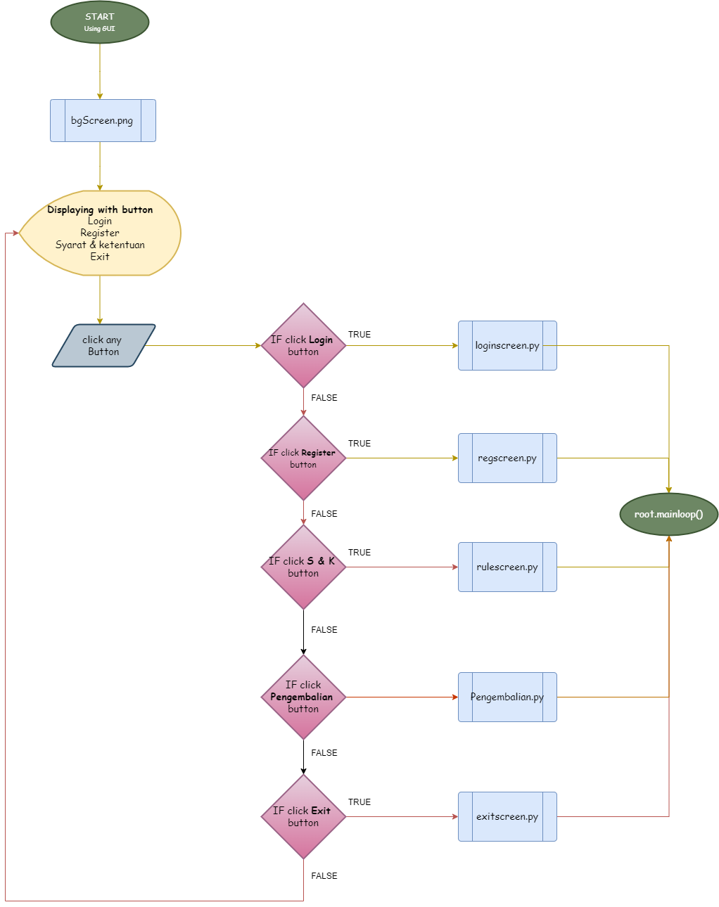
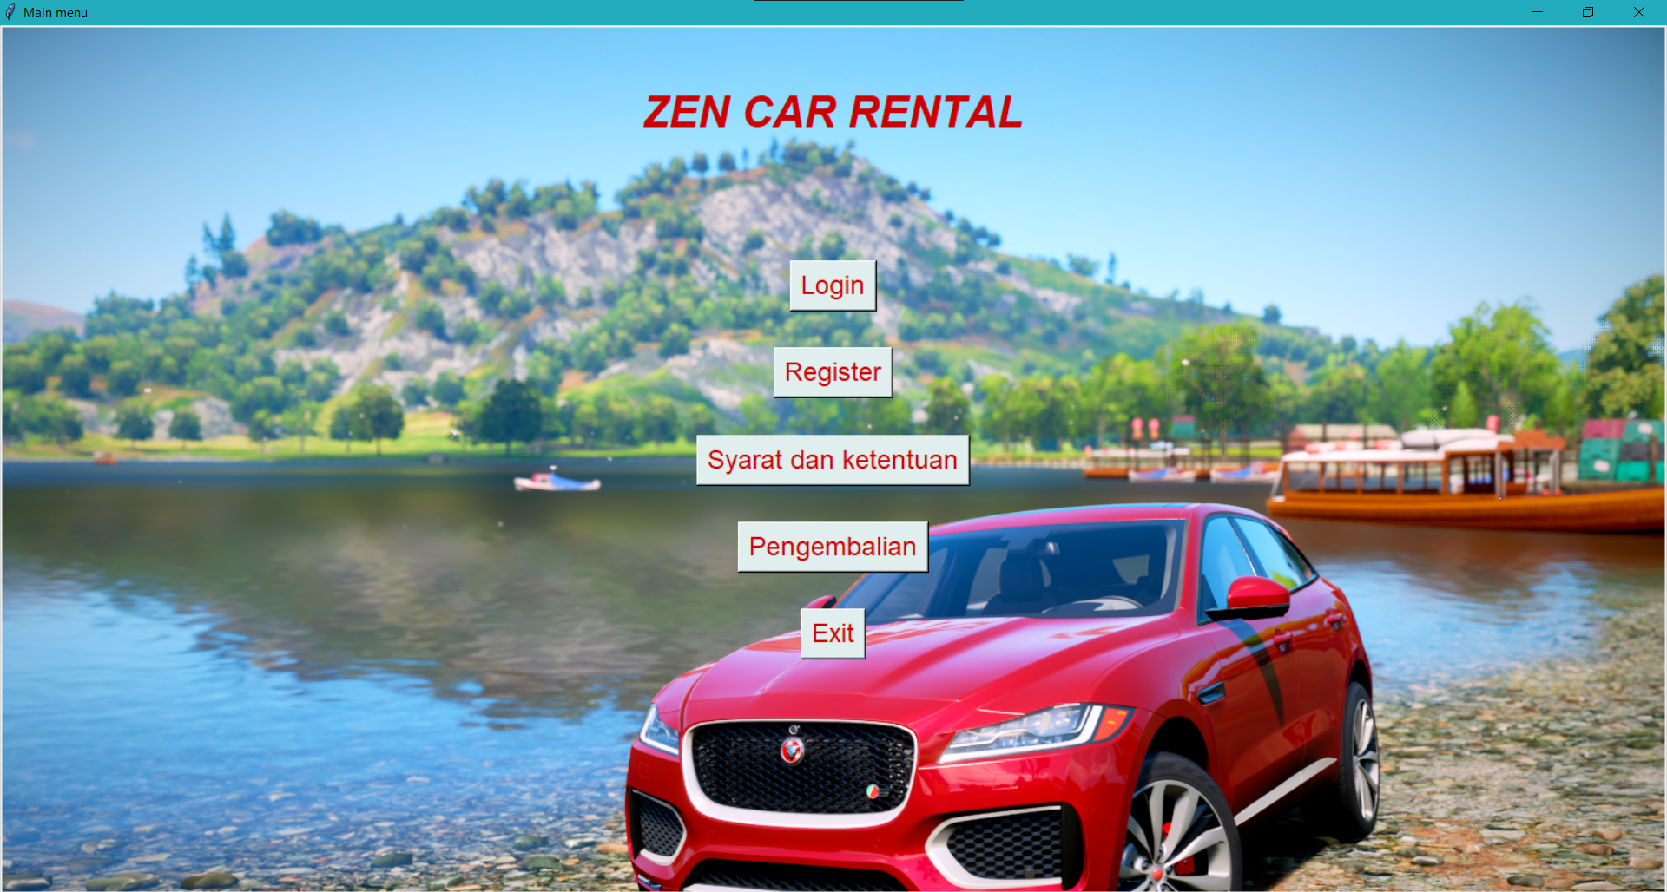
Main Menu
FLOWCHART
OUTPUT PROGRAM

Slide 7
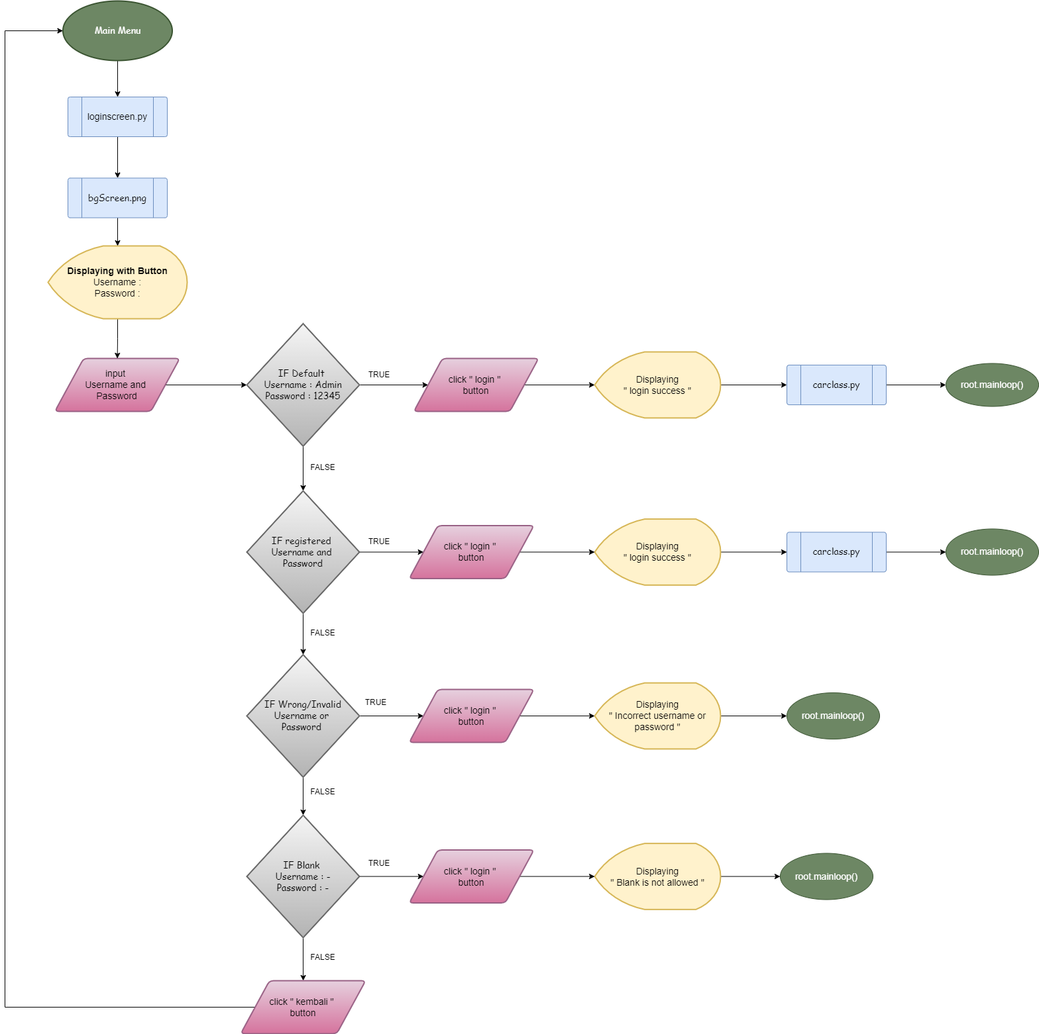
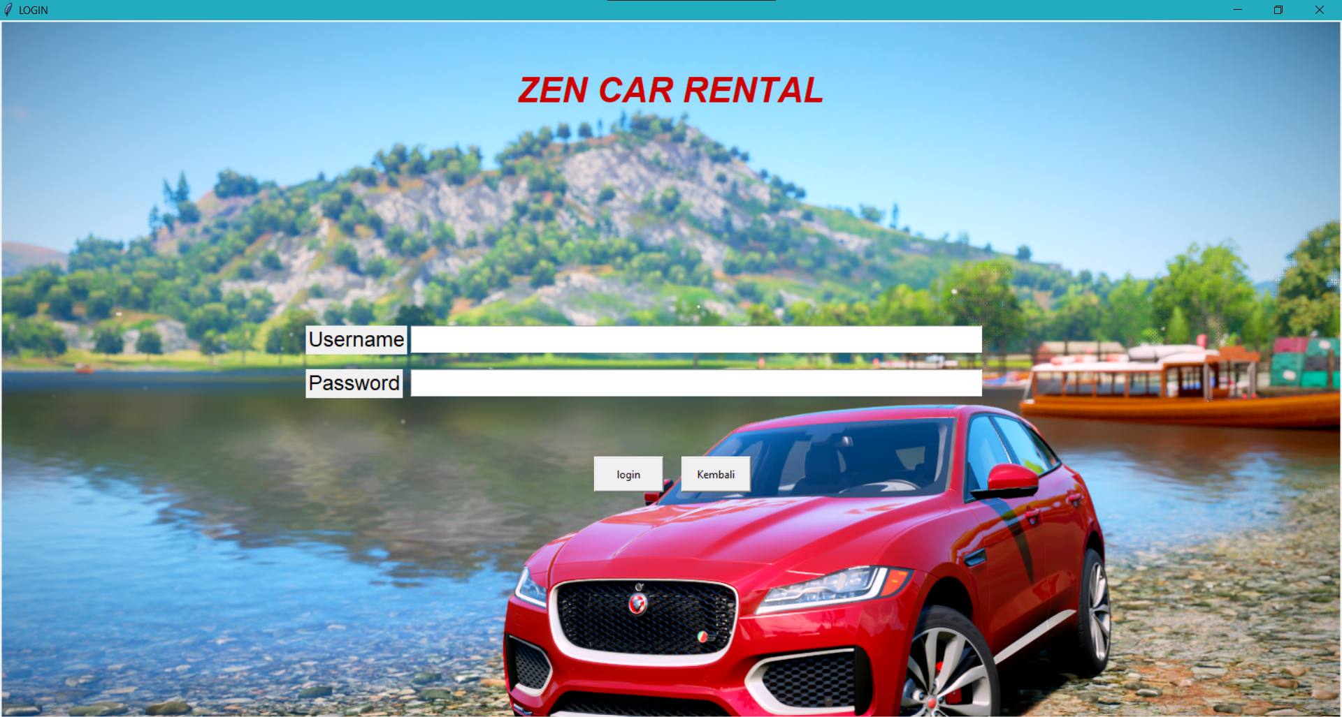
LOGIN SCREEN
FLOWCHART
OUTPUT PROGRAM

Slide 8
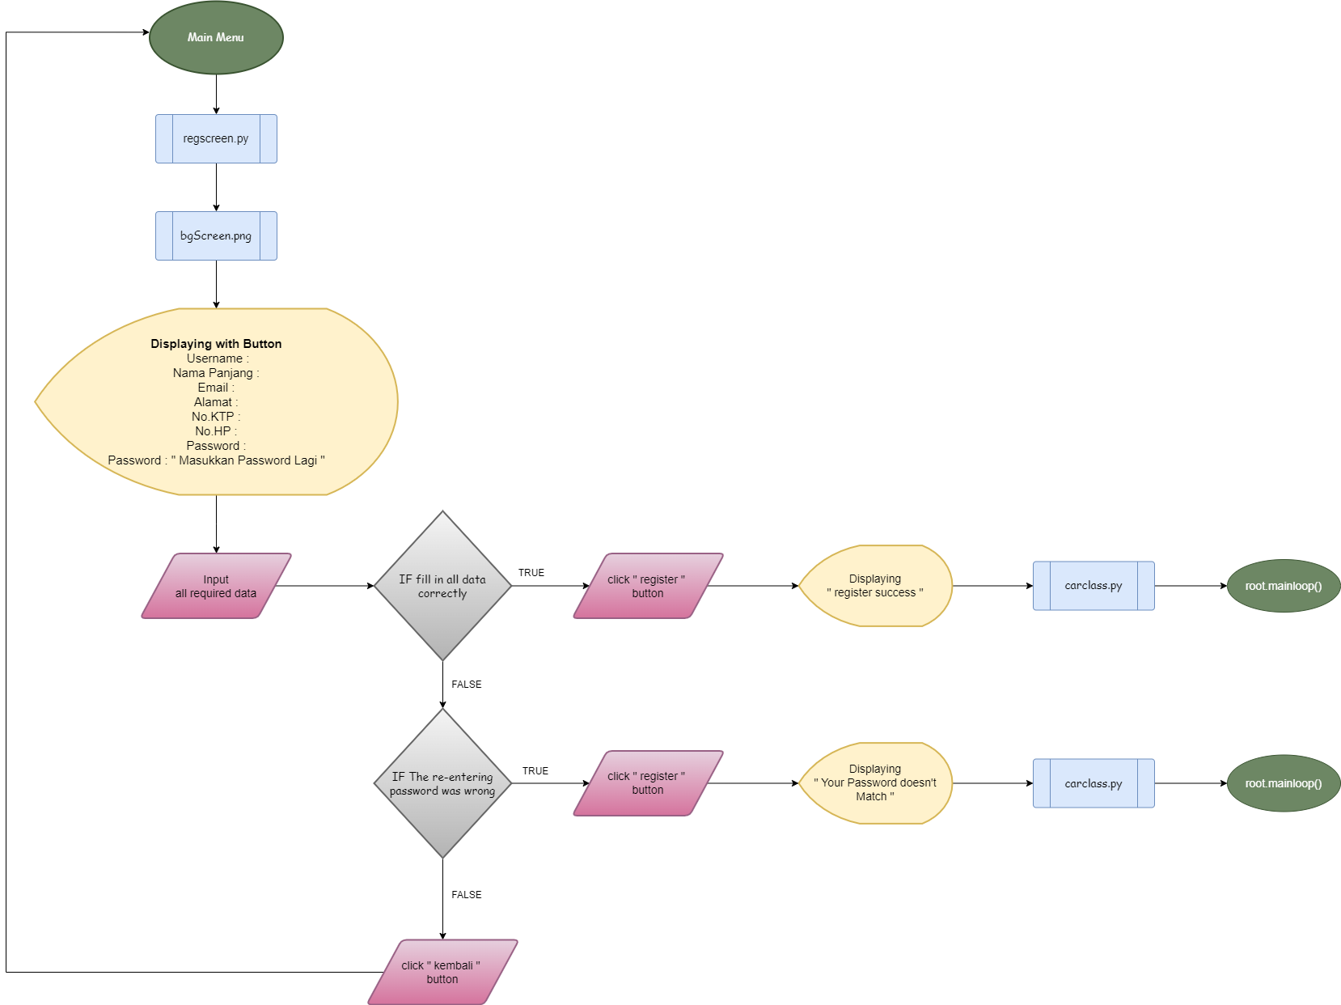
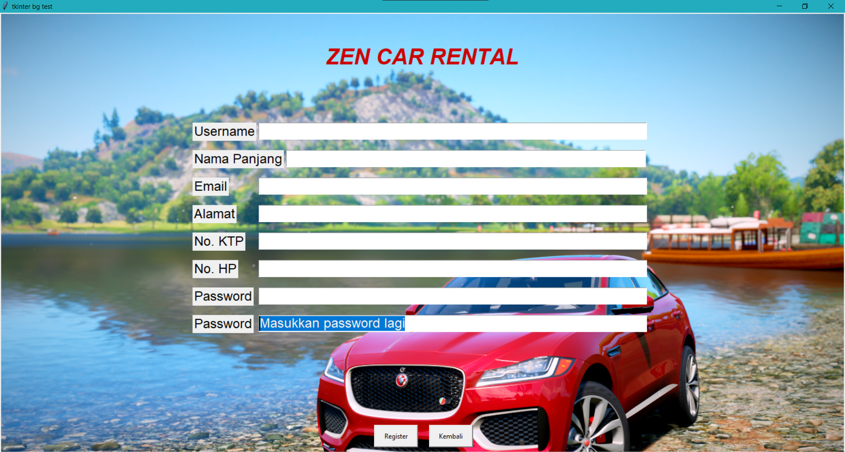
REGISTER SCREEN
FLOWCHART
OUTPUT PROGRAM

Slide 9
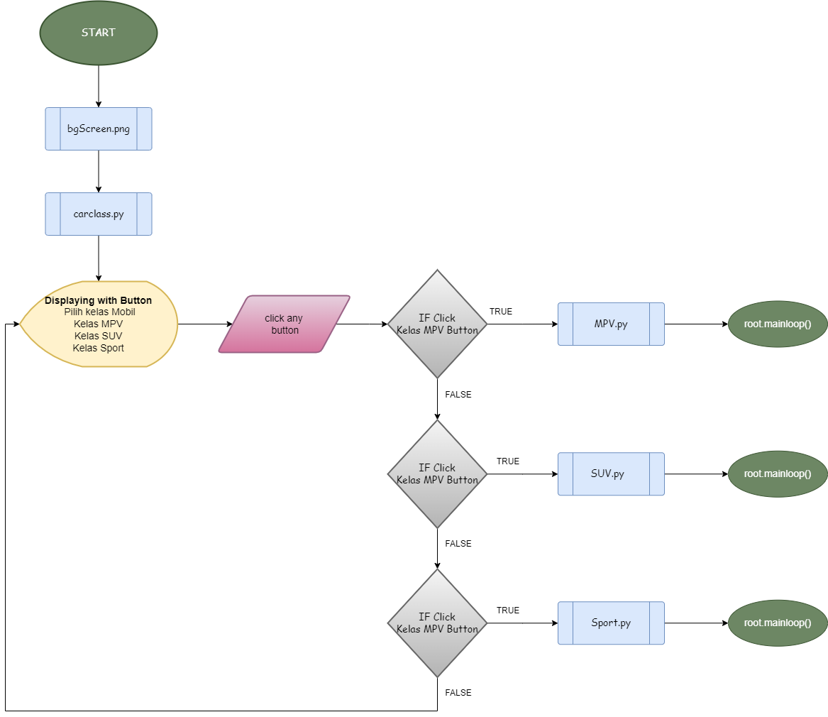
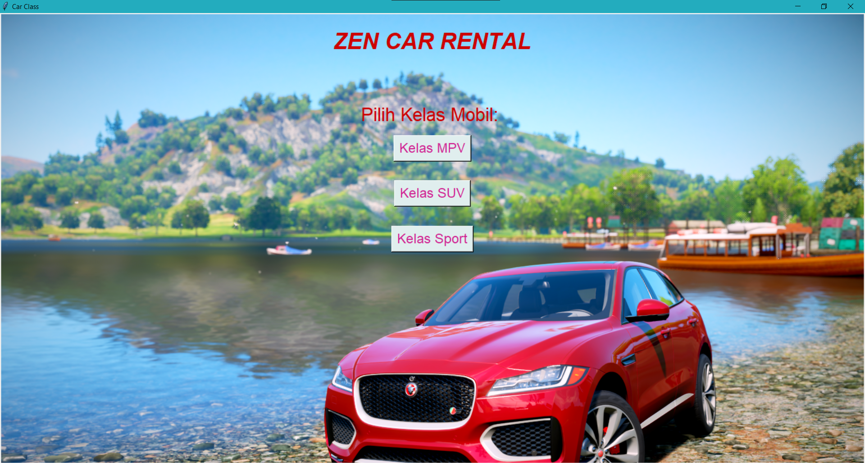
Class car selection
FLOWCHART
OUTPUT PROGRAM

Slide 10
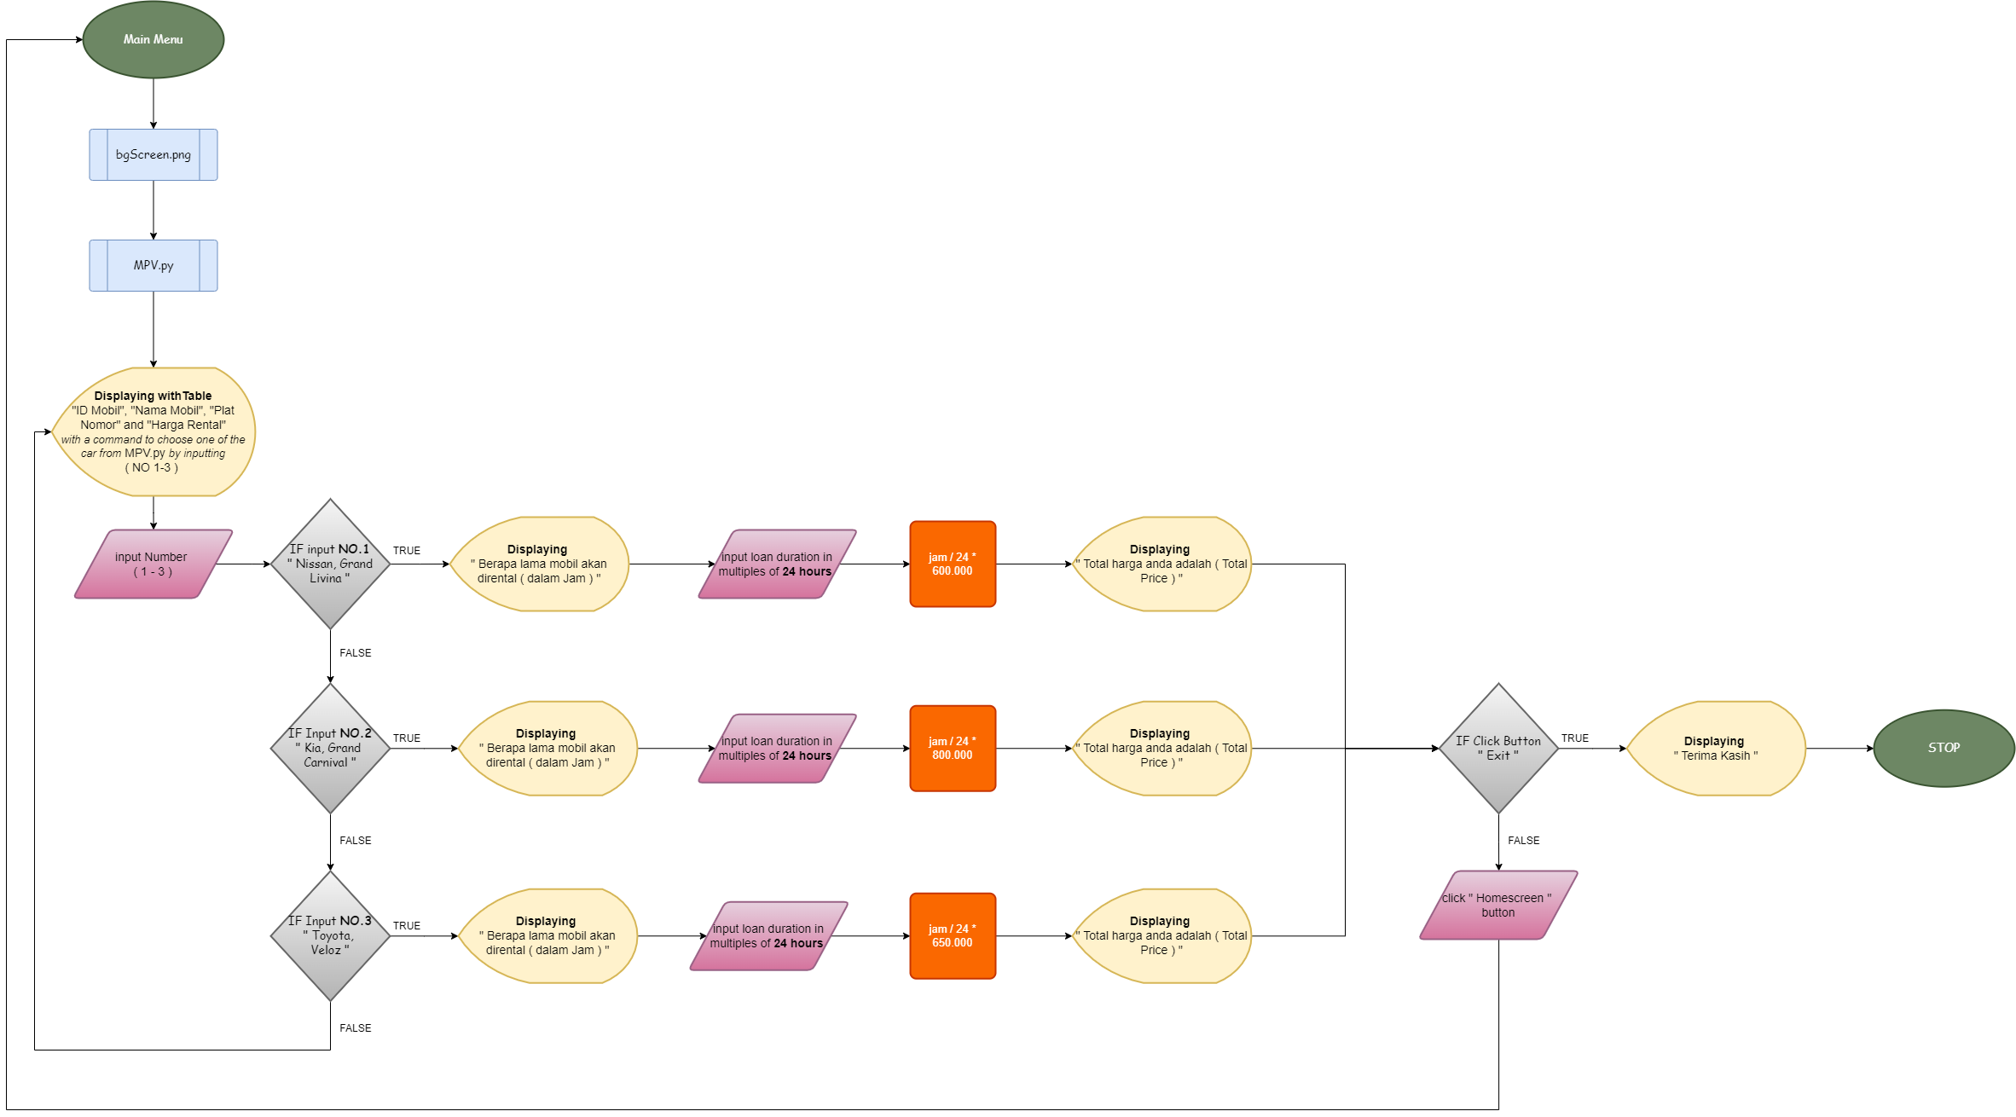
MPV CAR until the end of payment
FLOWCHART

Slide 11
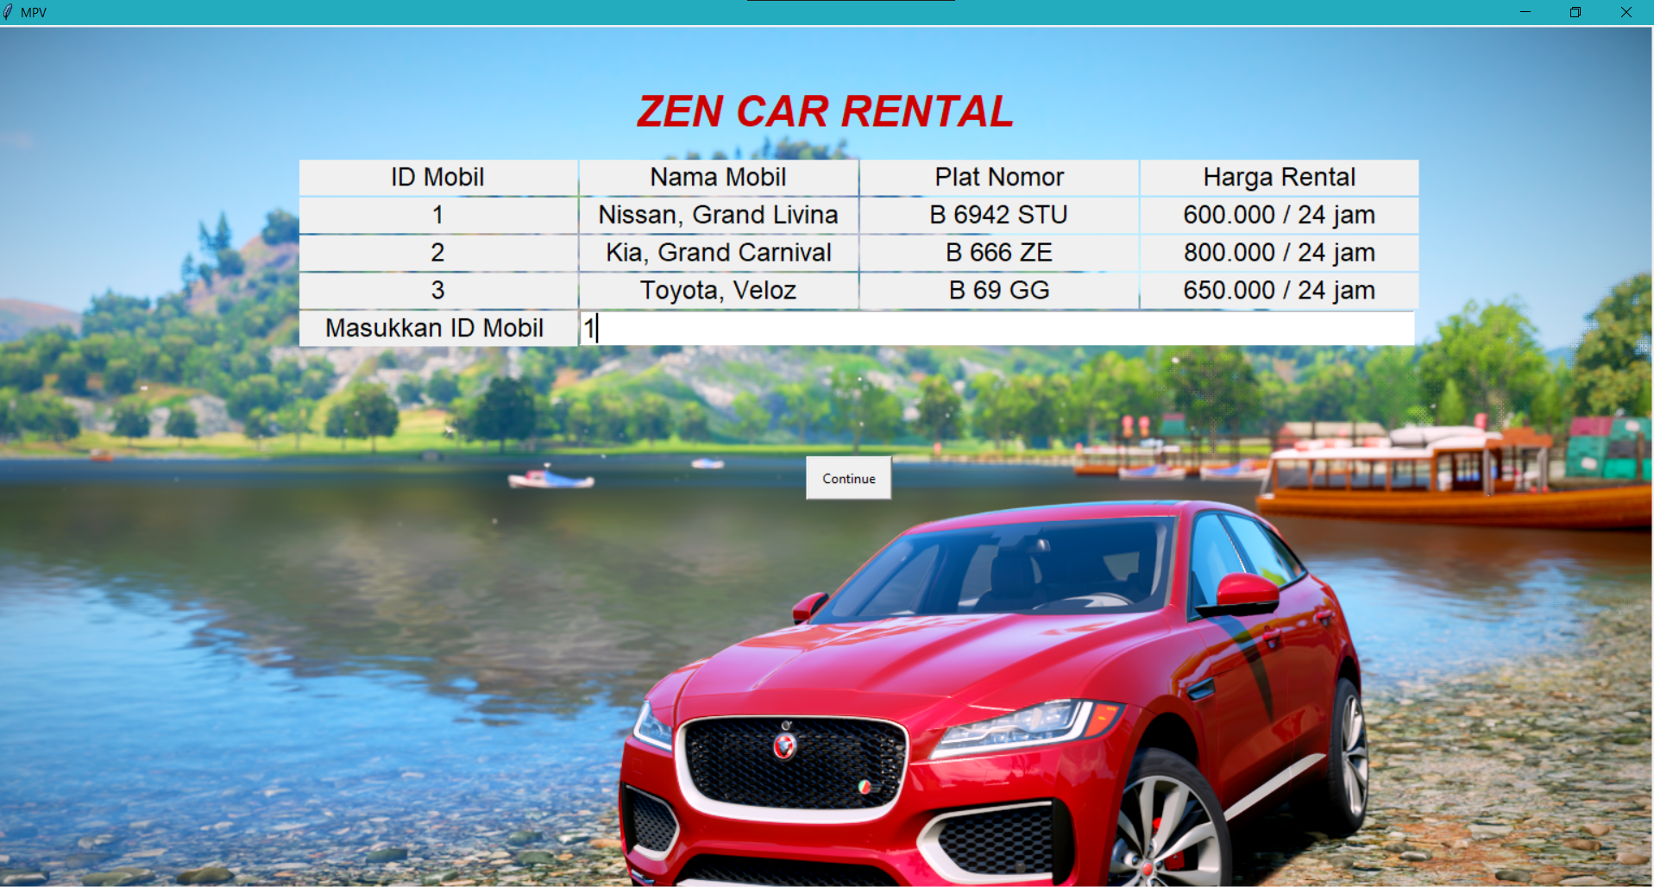
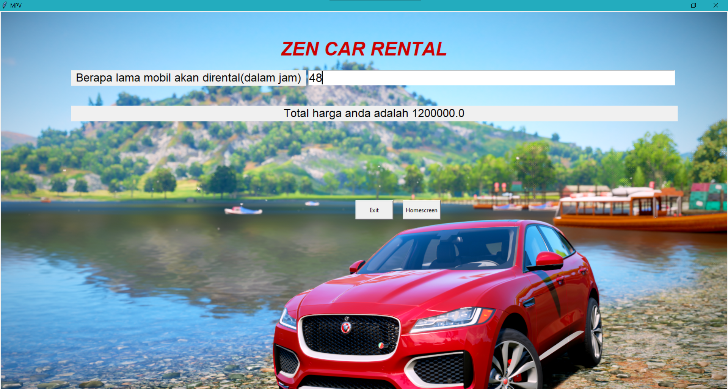
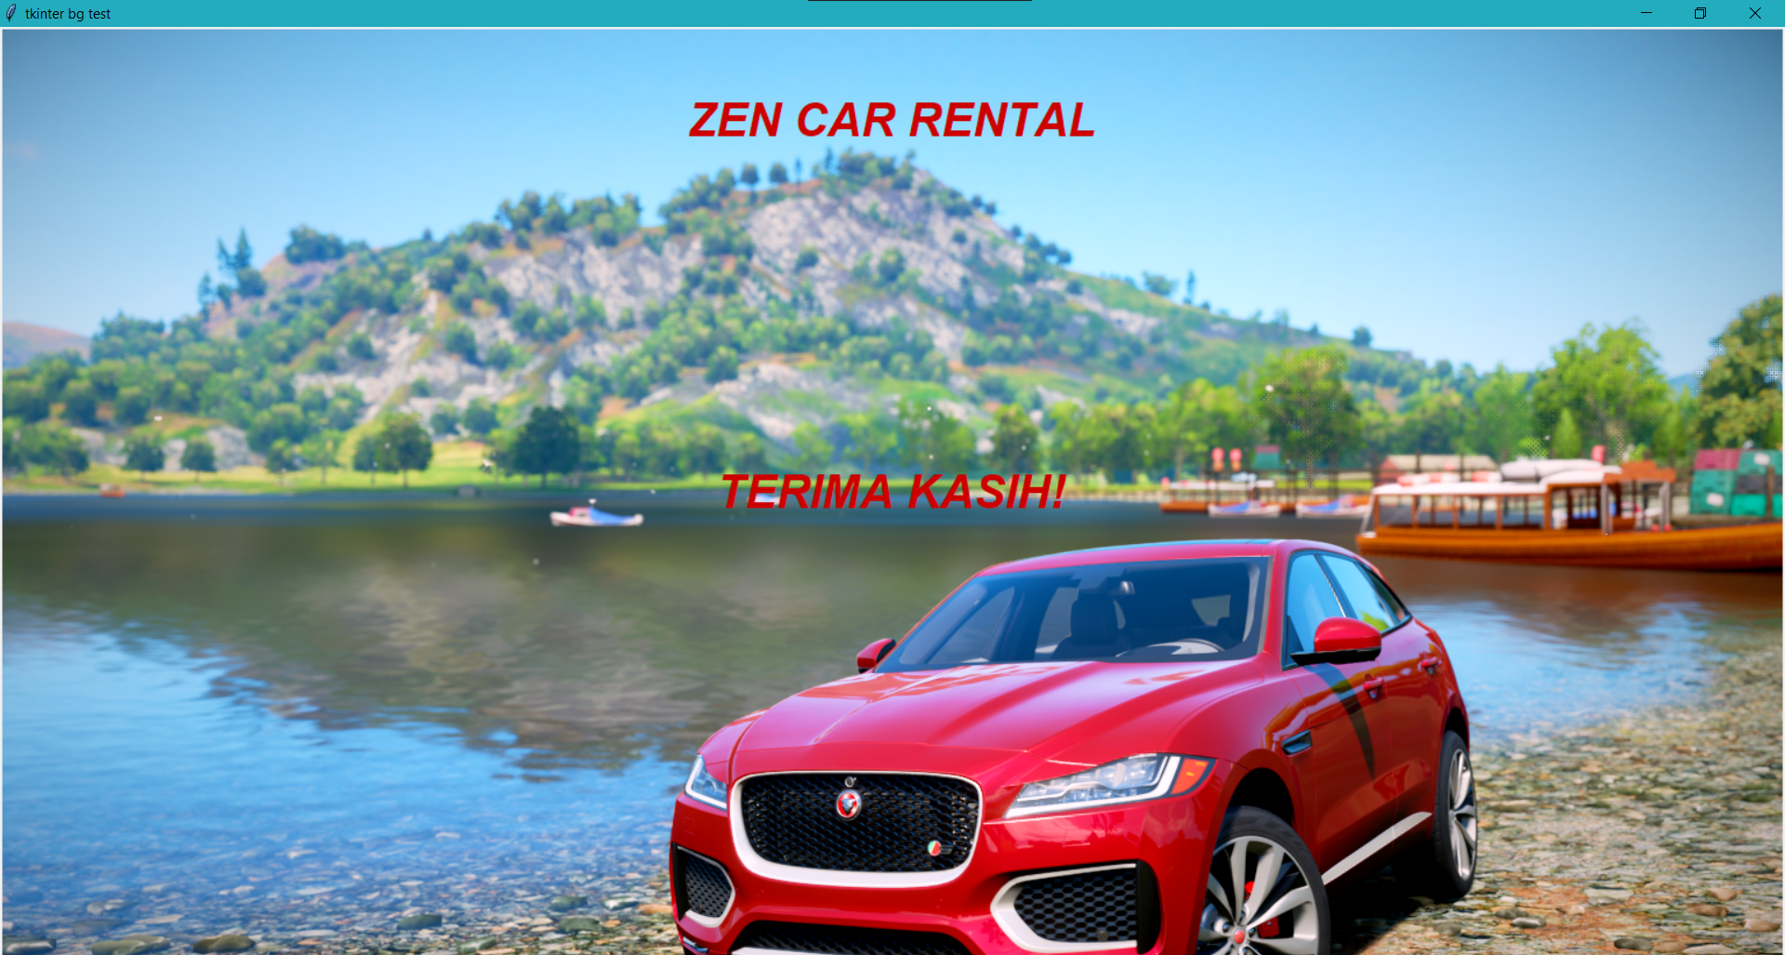
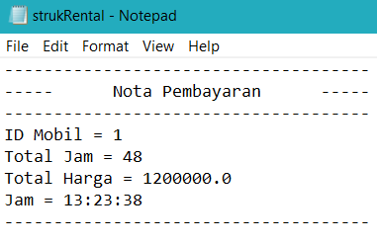
MPV CAR until the end of payment ( Output with bill )
1
2
3
4

Slide 12

SUV CAR until the end of payment
FLOWCHART

Slide 13


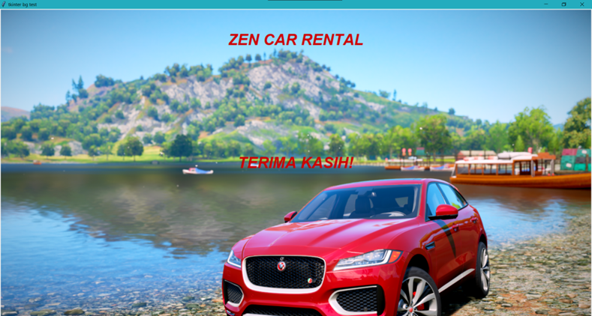
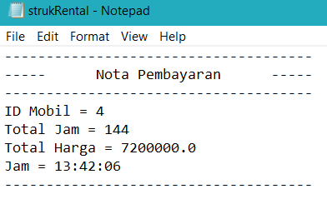
SUV CAR until the end of payment ( Output with bill )
1
2
3
4

Slide 14

SPORT CAR until the end of payment
FLOWCHART

Slide 15


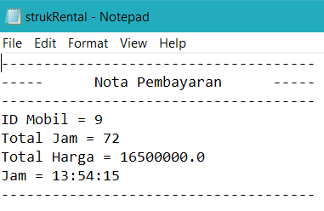
Sport CAR until the end of payment ( Output with bill )

Slide 16
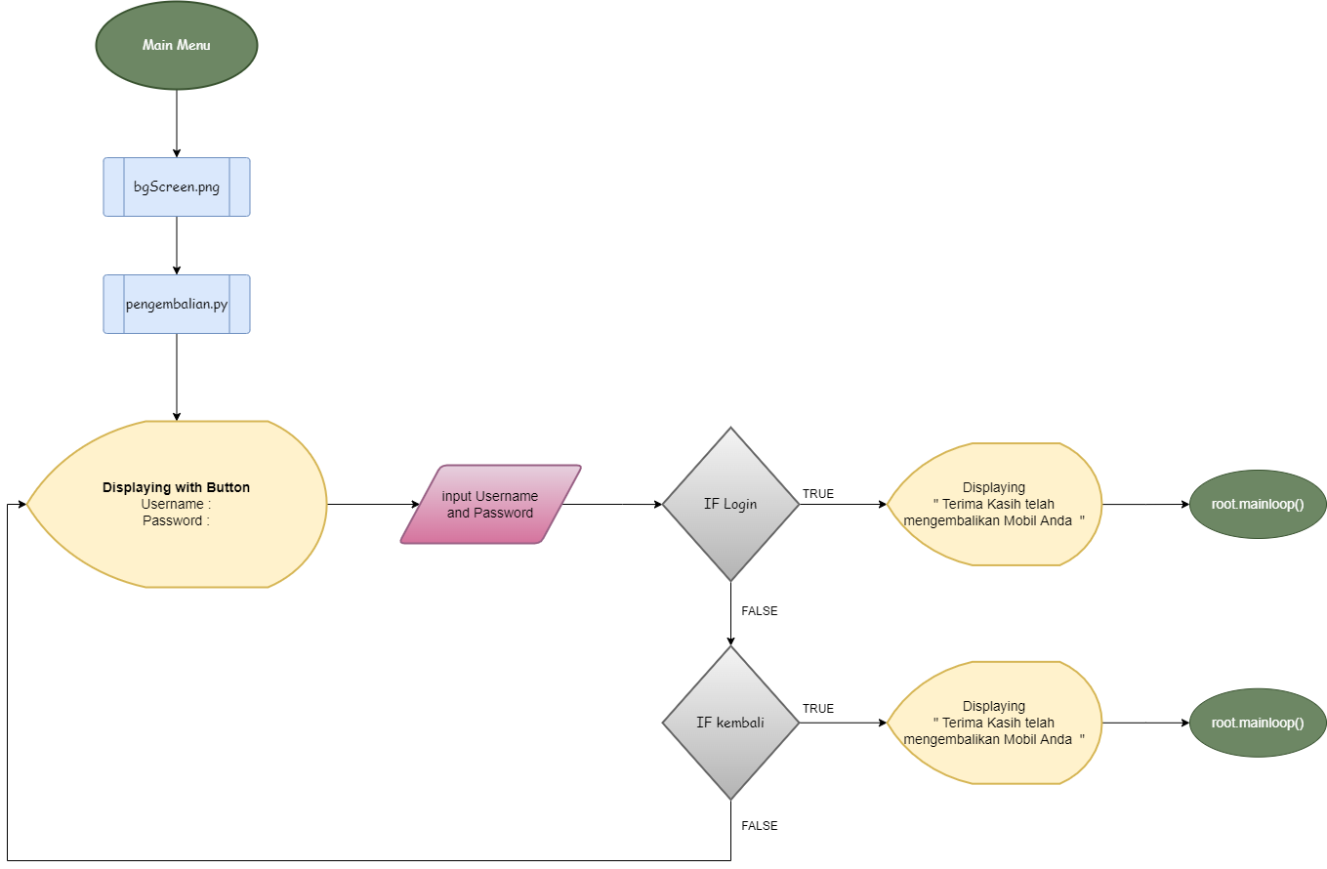
Pengembalian
FLOWCHART
OUTPUT PROGRAM

Slide 17
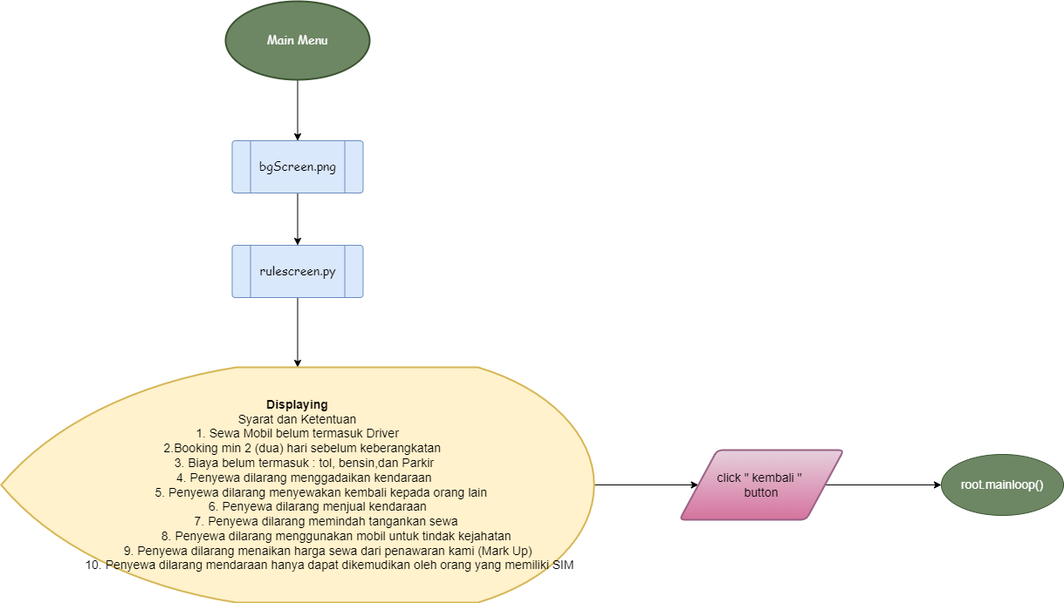
TERMS AND CONDITION
FLOWCHART

Slide 18
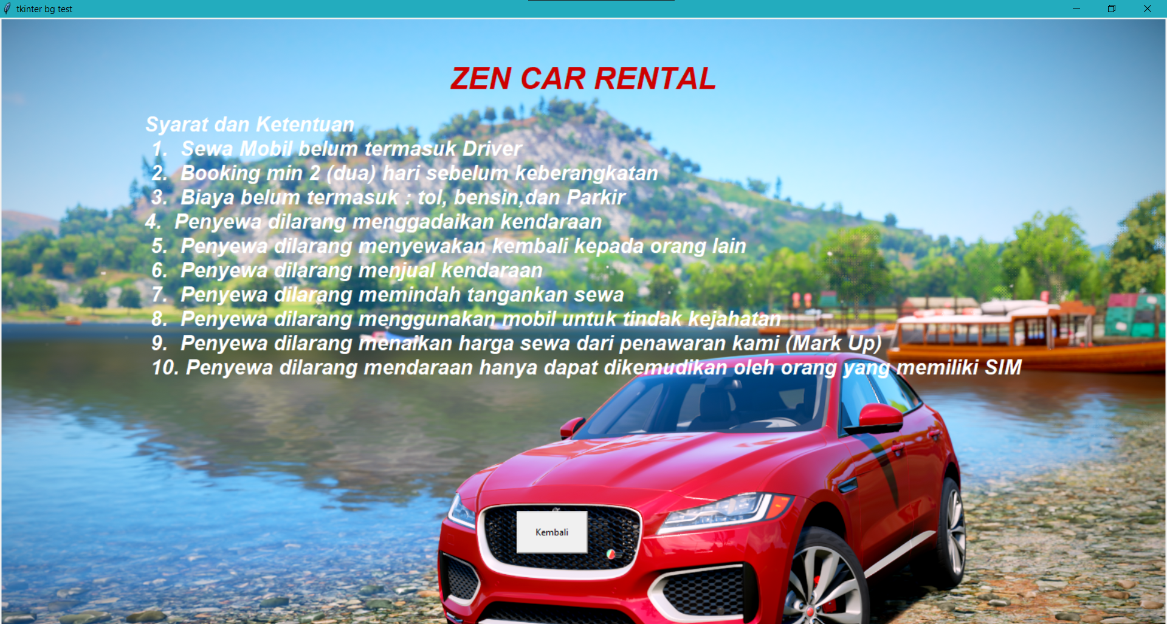
Output program

Slide 19
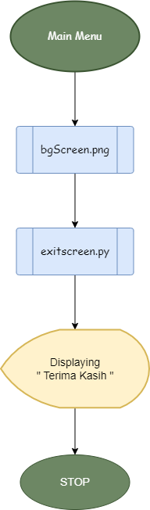
Exit screen
FLOWCHART
OUTPUT PROGRAM

Slide 20

THANK YOU FOR YOUR ATTENTION

